Slide 1

Marchants Hill
11th – 15th March

Slide 2
Staffing
The staff accompanying the children are:
Mr Fotheringham
Mrs Edgar
Mrs Mckeown
Mr Wilkie
Adventure activities are organised by P.G.L. and led by qualified instructors who are enhanced DBS checked.
Mrs Hawkins
Miss Tytherleigh
Mrs Owens

Slide 3
Behaviour Expectations
You are representing Southborough Primary School
If you behave in a way that brings our school into disrepute, your parents will be asked to come and collect you from Marchants Hill.

Slide 4
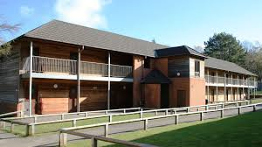
Accommodation
Rooms of 6 with 3 double bunk beds in each room.
Also en suite toilet and shower room.

Slide 5
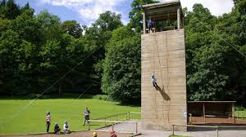
Activities
Activities are taught in groups of 10-12, each with a member of staff and a centre instructor.
Example activities include: climbing wall, abseiling, zip wire, a ropes course, archery, trapeze, rifle shooting and quad biking.

Slide 6
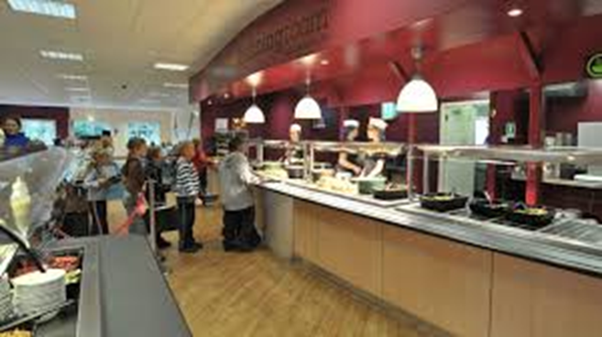
Food
Menu options are child-friendly, nutritious and provide good-sized portions.

Slide 7

Kit List Reminder
Please ensure you have a copy of this
EVERYTHING needs to be labelled.
Please bring clothes that won’t matter when they get wet and muddy.
Ensure your child can carry his/ her own case.
Holdalls are preferred to hard suitcases
as their storage is easier at the centre.
You can bring £15-£20 to spend in the shop

Slide 8

Do Not Bring:
Expensive cameras. Disposable cameras are better at bouncing when dropped!
Electrical items e.g. phones, Consoles, MP3 players, computer games, hair dryers etc.
‘Secret foods/ drinks’. We are not allowed them in the bedrooms.
Aerosols

Slide 9
Please Ensure The Following Are Handed Into Mrs Owens Before We Leave:
Medicines (and the instructions) including travel sickness tablets.
Calpol – we are not allowed to provide this
Asthma pumps – with instructions
All medicines in: Clear plastic bag
              Labelled
              Instructions for use

Slide 10
Travel Details
We are planning to get on the coach at 1.30pm on the Monday and return by 3.15 pm on the Friday.
Children will need to be in school normal time on Monday morning
Hoodies will be handed out that morning
If there are any alterations to this you will be notified.

Slide 11
Photos
Photos will be taken throughout the trip and will be available to purchase following our return

Slide 12
To Make The Trip More Enjoyable:
No phone calls please. We will contact you or the school if we need to.
Don’t be afraid to pack a ‘cuddly friend’ –just the one though!
Finally: Don’t tell them you’ll miss them! Instead let them know how excited you are for them. It’s hard but it helps!

Slide 13
Any Questions?
Thank you for taking the time to come to this meeting. If there are any questions or information that needs to be shared more privately, e.g. sleep walking, please speak to a member of staff at the end of this meeting.

Slide 14
Key points
Medical forms returned ASAP
All medicine labelled and handed in the morning that we leave.
No phones/ consoles etc
All clothes labelled
The children are responsible for their pocket money
Any questions, please feel free to pop in, call or email

