Slide 1
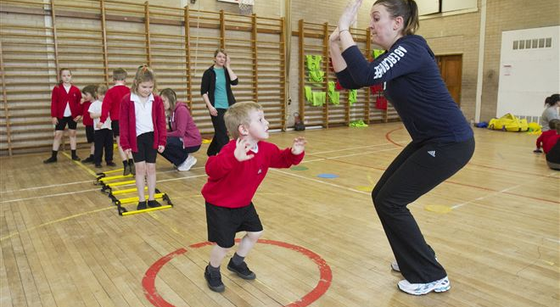
Primary PE & Sports Premium –
SMT Subject Leader Introduction & Promotion
(Spend & Impact Case Study)
Subject Leader: Sarah Wimshurst
Borough Primary PE & Sports CPD Advisor: Giles Platt

Slide 2
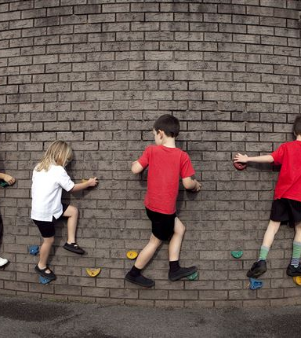
PESS Premium
All schools with 17 or more primary-aged pupils will receive a lump sum of £8000 plus a premium of £5 per pupil. (£8,260 to £12,520)
Paid via Additional Grant for Schools (AGS) 2013-2016
Schools will have to spend the Government grant funding on improving their provision of PE and sport, but they will have the freedom to choose how they do this.
Schools are accountable for their spending and must document both precise spend and impact online so that parents are able to monitor and compare effect with the performance of other regional schools
Ofsted; new assessment criteria

Slide 3

Benefits of Active Healthy Lifestyle

Slide 4
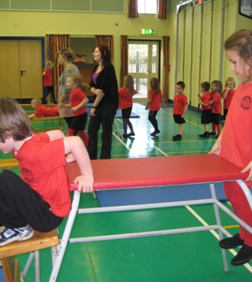
Options Include:
hiring specialist PE teachers or qualified sports coaches to work alongside primary teachers when teaching PE
new or additional Change4Life sport clubs
paying for professional development opportunities in PE/sport
providing cover to release primary teachers for professional development in PE/sport
running sport competitions, or increasing participation in the school games
buying quality assured professional development modules or materials for PE/sport
providing places for pupils on after school sport clubs and holiday clubs
*other initiatives that promote active healthy lifestyles:
‘A few of the schools had used a small part of the funding to promote pupils’ health and well-being, including providing help for those pupils who were overweight or obese. However, overall, this was not done well enough in the majority ‘
(Ofsted - The PE & Sport Premium for Primary Schools –
Good Practice to Maximise Effective Use of the Funding)
http://www.ofsted.gov.uk/sites/default/files/documents/surveys-and-good-practice/t/The%20PE%20and%20sport%20premium%20for%20primary%20schools.pdf

Slide 5
Stepping Stones to Sustainable Success
Improve quality and diversity of PE and School Sport
Address high quality resourcing
Focus upon the interests and needs of your pupils
Review all documentation that affects quality of whole school ethos and delivery re: Active Healthy Lifestyles
Identify sustainable quality criteria
Review and update training requirements of staff and other delivery agencies
Adopt PRIDE (Olympic & Paralympic Values)
Collaborate and impact upon the wider school community
Celebrate and promote both HQ ethos & provision, as well as both pupil and staff achievements and commitment

Slide 6
2014 PE Curriculum Changes

Slide 7
1 : 1 Subject Leader Management Support
PESS Premium Evidence of Spend & Impact 2013-2014 & 2014-2015
Physical Education policy updated
Gifted & Talented / Assessment policy update to factor in Physical Education
Subject development planning
Bromley Primary Sports website familiarisation
National Curriculum framework document Sept 2013 and all subsequently published DfE literature since then , as also available via www.bromleyprimarysports.co.uk
AfPE School Membership
AfPE Quality Mark registration and application preparation
Resources order incl. Subject Leader & Non-Specialist PE & Sport-Specific resource ideas
Assessment incl. subject level age descriptors
Play Leaders – mentoring for Supervisors
Intra Competition framework & delivery
Fitness Station planning
School Sports Organising Crew / School Sports Council impact
Healthy Schools Silver / Gold award application
Sainsburys School Games profiling
Diet & Nutrition activity resourcing via Coolings Schools Liaison Officer
Registration to Jamie Oliver’s Kitchen Project
Olympic & Paralympic values

