Slide 1




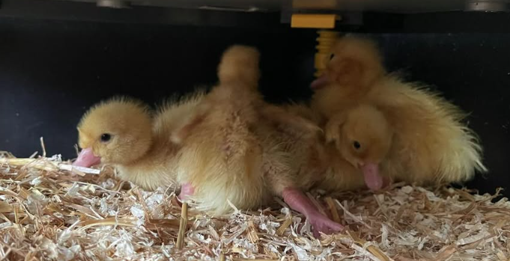
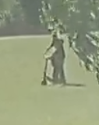
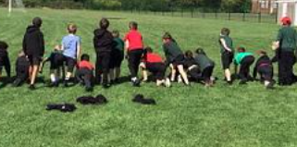

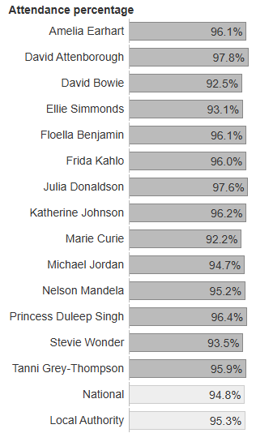
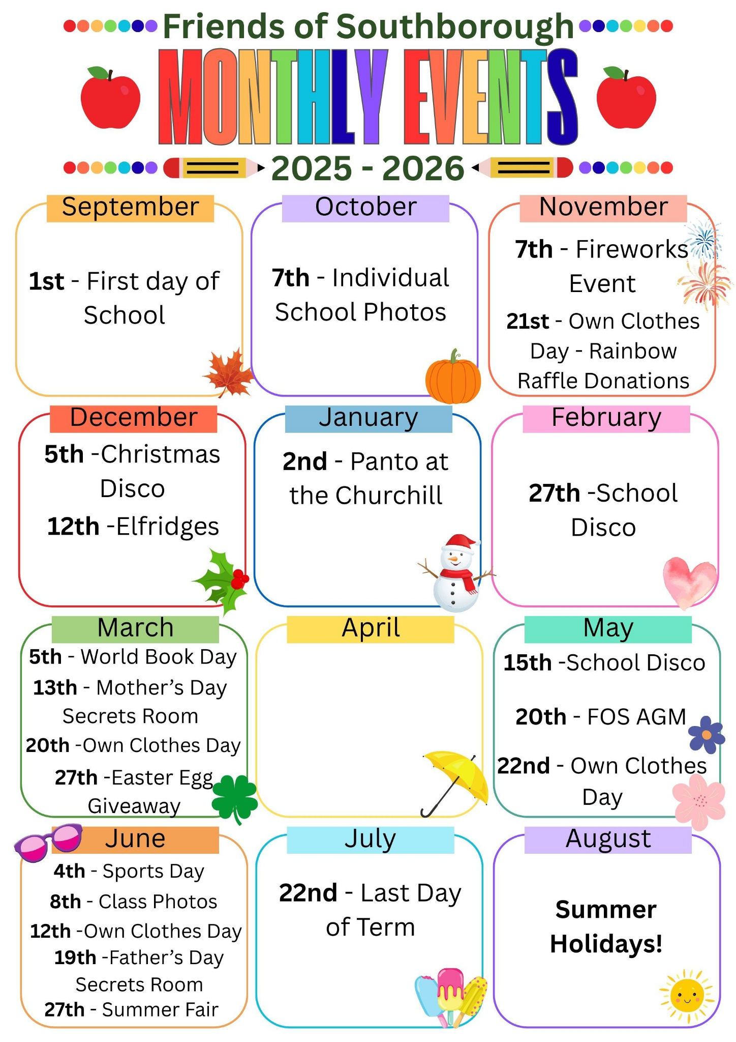
Date: 24.4.26
CLICK ME
Whole school attendance 95.1%
Message from Mrs Berthoud
This week the children have completed a mini marathon (2 miles) by running two laps of the field each day across the week.
Each child who completed it will received a certificate so well done them!
Thank you Miss Banda for organising and for Coach Taylor and the staff for ensuring the time was given to running the laps too.
LEARNING
The children in Recpetion have been learning about the lifecycle of ducks this week with the arrival of eggs - which hatched into ducklings. This is one of the Pioneer Passport activities children experience in their time at Southborough.
SAFE
This week an adult was riding on an electric scooter on the field at the end of the day. This is highly dangerous.
A reminder that no body should be riding electric scooters, scooters or bikes on our grounds please.
Attendance Matters
Who is 96%+?
HAPPY
The Year 6 play leaders are doing a brilliant jobs of playing with KS1 children at lunchtime… Mrs Berthoud loves looking out the window and seeing what they are doing each lunchtime from bat and ball to parachute games.
Bank Holiday
Monday 4th May
Y6 SATS week -
Monday 11th May - Thursday 14th May
Half term
Monday 25th to Friday 29th May
INSET day - school closed Monday 1st June
Last day of Summer term
Wednesday 22nd July
First day of Autumn term
Tuesday 1st September
FOS

Slide 2




Slide 3

https://forms.gle/HpzwQs5r3Vq2jT5g7

Slide 4
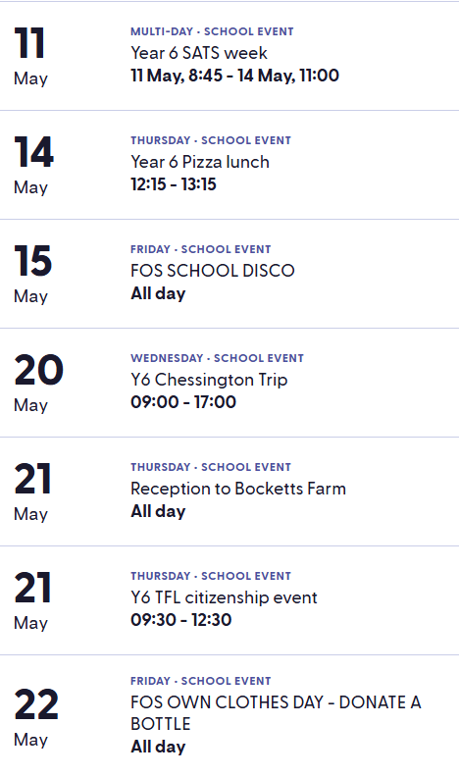
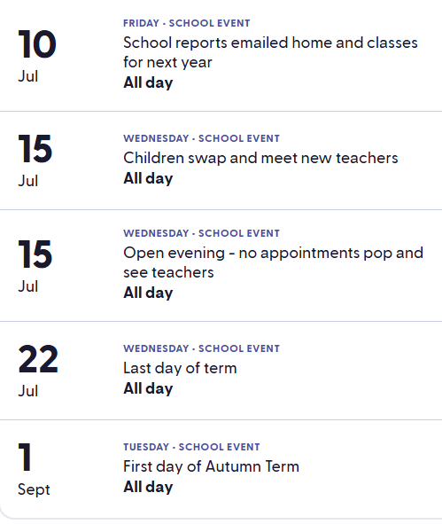
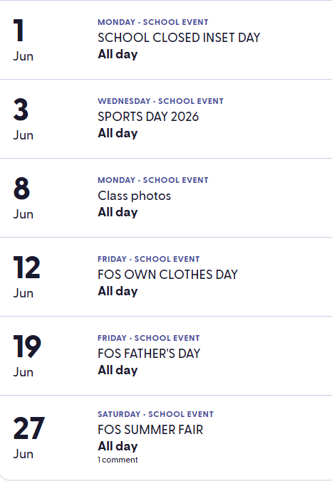

COLOUR RUN
Do sign up for this year’s colour run if you would like to take part on Monday 20th July 2026.
https://forms.gle/4odM5pKrQetzE2FJ9

